Slide 1




AC-DC: Adaptive Ensemble Classification for Network Traffic Identification
Xi Jiang¹, Shinan Liu¹, Saloua Naama², Francesco Bronzino³, Paul Schmitt⁴, Nick Feamster¹
Committee member: TBD
1
2
3
4
Notes:
Focus: general classification framework for network traffic on the flow-level

Slide 2
Network traffic classification is widely used
What to classify?
Why do we need classification?
Notes:
Techniques of network traffic classification have always been applied and there some common tasks that we see

Slide 3
Network traffic classification is widely used
What to classify?
Video streaming services
Video conferencing apps
Social media websites
Anomaly detection
…
Why do we need classification?
Notes:
These includes examples such as…
And the reason why we need these tasks are intuitive, as many essential network operations depend on the prediction results,

Slide 4
Network traffic classification is widely used
What to classify?
Video streaming services
Video conferencing apps
Social media websites
Anomaly detection
…
Why do we need classification?
Capacity planning
QoS monitoring
Traffic prioritization
Malicious traffic detection
…
Notes:
Such as…

Slide 5
Two approaches for classifying network traffic
Notes:
In modern Internet, there are two prominent ML-based approaches for traffic classification.

Slide 6
Two approaches for classifying network traffic
Flow-statistics-based ML
Notes:
In the early days, we have relatively simple techniques that utilize aggregated flow statistics

Slide 7
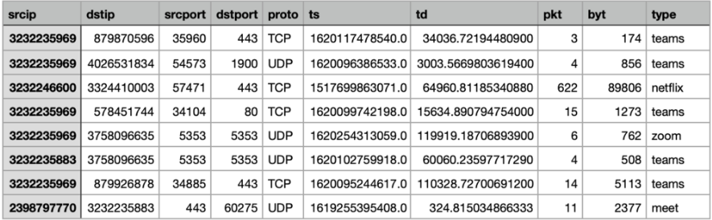
Two approaches for classifying network traffic
Flow-statistics-based ML
Inter-arrival-time, packet sizes, port numbers, etc.
Notes:
These include … and a few other common netflow-type attributes. However, as the Internet becomes more encrypted and consolidated, these few attributes are less accurate in predicting the traffic.

Slide 8
Two approaches for classifying network traffic
Packet-Capture-based (e.g., PCAPs) ML/DL
Notes:
To address this, people started to use packet captures which naturally contains more detailed and fine-grained features and information than can be learned rather than aggregated statistics of network flows.

Slide 9
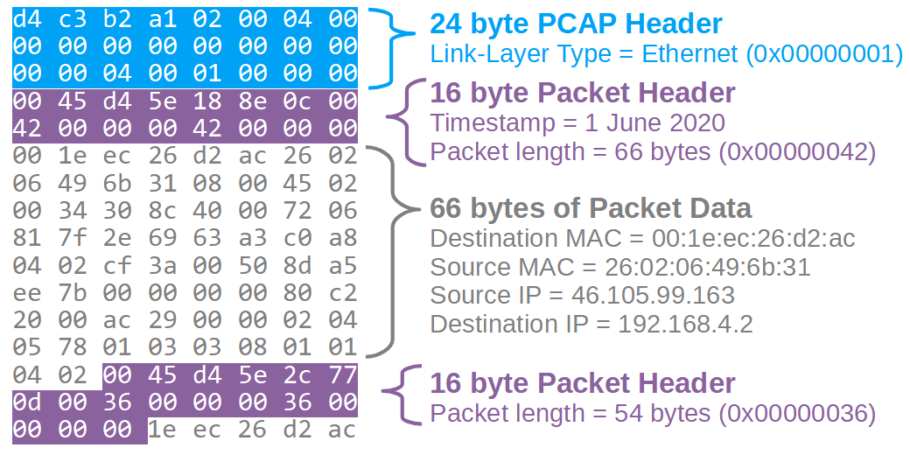
Two approaches for classifying network traffic
Packet-Capture-based (e.g., PCAPs) ML/DL
Packet headers, payloads, etc.
Notes:
In this presentation, we focus on packet-capture-based classifiers that use pcap files, such as the header level information.

Slide 10
Two approaches for classifying network traffic
Flow-statistics-based ML
Packet -Capture-based ML/DL
There is a trade-off on efficiency and performance (accuracy) for these efforts.
Notes:
However, there is a trade off between efficiency and performance.
Statistics is faster and less resource intensive because there are less features to use and there is little processing of these features needed if at all,
But these methods are becoming less accurate as we suggested.
On the other hand, while packet-capture is more accurate, it is also slower and has higher space complexity because it’s target/feature space is more complex to process. Consider deployment settings such as
Routers and middlesboxes where large volumes of traffic pass through at fluctuating rates but onboard mem is low, this becomes problematic.

Slide 11
Content
Trade-off demonstration
Framework design
Evaluation results
Notes:
To start this off, we first quantify the trade-off

Slide 12
Demonstration: performance vs. efficiency trade-off
Existing methods:
Flow-statistics-based
Bernaille06 (GMM), SwiftIDS (LightGBM), Lai20 (XGBoost), and Flowrest (Random Forest)
Packet-Capture-based
Isingizwe21(LightGBM), IIsy (XGBoost), pForest (RF), and Deep-Packet (CNN)
Notes:
To do this we select 4 prominent classifiers from each type of the classification methods.
These include both early representative works and more state-of-the-art classifiers.

Slide 13
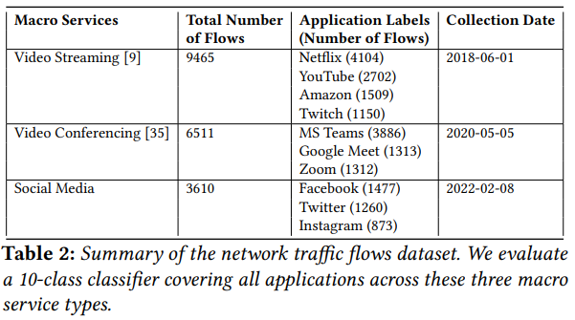
Demonstration: performance vs. efficiency trade-off
Task: Line rate flow-Level application classification across 10 different applications.
Notes:
And the specific classification task that we look at is application identification, in this presentation, we are looking at a 10-class classification task that span across 3 macro service types including…

Slide 14
Demonstration: performance vs. efficiency trade-off
Task: Line rate flow-Level application classification across 10 different applications.
Traffic rates: Varying from 10 to 7,000 flows/second
Notes:
And to simulate a real network interface with varying traffic rates, we randomly sample and replay the network flows from our dataset with an increasing rate that starts from 10 flows per second to…

Slide 15
Demonstration: performance vs. efficiency trade-off
Task: Line rate flow-Level application classification across 10 different applications.
Traffic rates: Varying from 10 to 7,000 flows/second
Assumption*: A new classifier instance is called every second to classify all flows collected from the previous second.
Notes:
At the same time, because most existing classifier are designed and evaluated to carry out classification in an offline setting, we modify them so that…

Slide 16
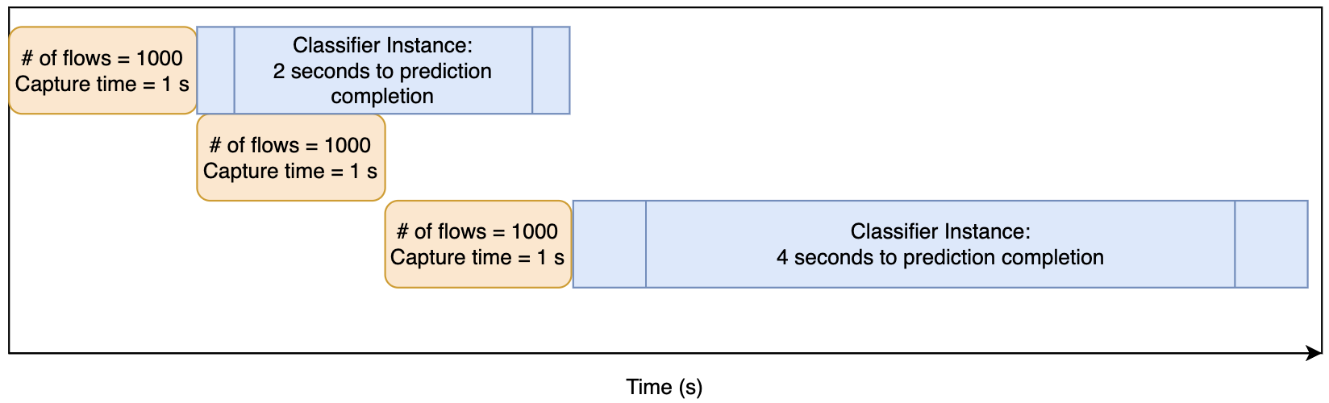
Demonstration: performance vs. efficiency trade-off
Assumption*: A new classifier instance is called every second to classify all flows collected from the previous second.
Notes:
The intuition behind this is simple, in most online classifiers, it is more efficiency to carry out batching preprocessing and predication once enough data have been collected, rather than going through the process each time when a new data point arrives. So let’s assume that you have traffic coming in at 1000 flows per second, that is it take you 1 second to capture 1000 flows. If you feed this 1000 flows captured during the previous second to a classifier instance and it takes the classifier 2 seconds to complete all the predications before you can free that classifier, now the classifier is left with 2000 flows to predict that was collected during the 2 seconds when it was dealing with the previous batch, and let’s say it now takes 4 seconds for the classifier instance to finish all the prediction. It is easy to see that after a few iterations it’s going to take the classifier instance longer and longer to complete predictions. And we do not want that because this can cause many problems, for example we can have buffer overflow just by store all that growing number of flows when waiting for the classifier to finish the previous batch.

Slide 17
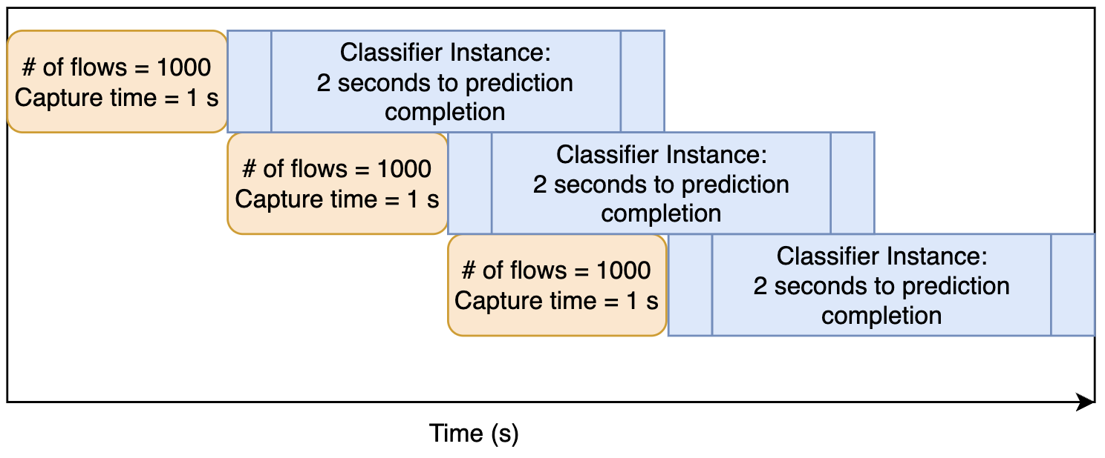
Demonstration: performance vs. efficiency trade-off
Assumption*: A new classifier instance is called every second to classify all flows collected from the previous second.
Notes:
So a more reasonable thing to do is to periodically calling on new instances of classifiers instead of waiting for a running one to finish, therefore our assumption.
So now with this out of the way, we look at the metrics we use to measure efficiency and performance.

Slide 18
Demonstration: performance vs. efficiency trade-off
Metrics:
Performance: F1 score
Notes:
For performance, it is simple here we use F1-score of the classification results to denote that, you can also replace this with other metrics such as ...

Slide 19
Demonstration: performance vs. efficiency trade-off
Metrics:
Performance: F1 score
Efficiency:
Time to Decision (TTD)
Memory Usage
Notes:
For efficiency we look at two metrics which include …

Slide 20
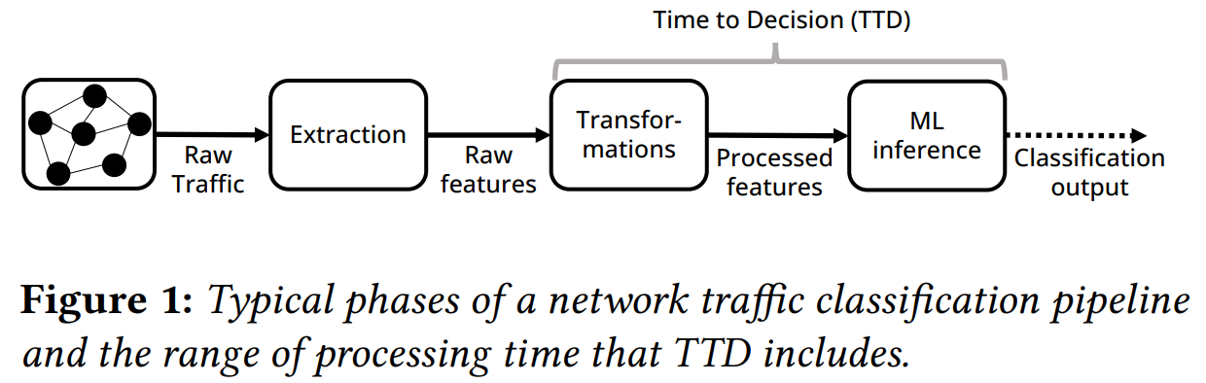
Demonstration: performance vs. efficiency trade-off
Efficiency: Time to Decision (TTD)
Notes:
For time to decision, in this specific study, we focus on the amount of time the classifier takes from inputting extracted raw features to completing predication on all of the flows that is fed into the classifier. We do not want to include the extraction time for the raw features because in network…

Slide 21
Demonstration: performance vs. efficiency trade-off
Efficiency: Memory Usage
Minimum amount of RAM and SWAP memory needed
Notes:
Another metric that we look at for efficiency is …

Slide 22
Demonstration: performance vs. efficiency trade-off
Efficiency: Memory Usage
Minimum amount of RAM and SWAP memory needed
Assumption*: A new classifier instance is called every second to classify all flows collected from the previous second.
Notes:
Recall our assumption where…

Slide 23
Demonstration: performance vs. efficiency trade-off
Efficiency: Memory Usage
Minimum amount of RAM and SWAP memory needed
Assumption*: A new classifier instance is called every second to classify all flows collected from the previous second → More than 1 instances of classifiers running concurrent if TTD > 1s.
Classifier 1
Classifier 2
Classifier 3
Notes:
It is extremely likely if not always that there is … that is a new instance starts to run before the previous one finishes.

Slide 24
Demonstration: performance vs. efficiency trade-off
Efficiency: Memory Usage
Minimum amount of RAM and SWAP memory needed
Assumption*: A new classifier instance is called every second to classify all flows collected from the previous second → More than 1 instances of classifiers running concurrent if TTD > 1s.
Classifier 1
Aggregated
Memory
Usage
Classifier 2
Classifier 3
Notes:
In this case, we calculate …

Slide 25
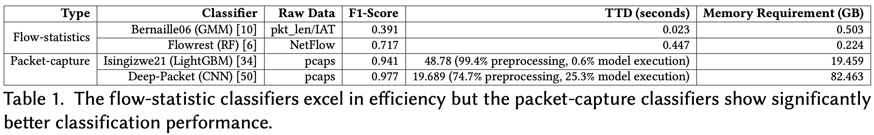
Demonstration: performance vs. efficiency trade-off
Average results across tested traffic rates:
Notes:
We now look at how the existing flow.. And packet… classifiers do against the task. Here we select 2 representative classifiers from each type for simple presentation

Slide 26
Demonstration: performance vs. efficiency trade-off
Average results across tested traffic rates:
Takeaways:
Flow-statistics classifiers are substantially more efficient in TTD and Memory Requirement.
Notes:
It is easy to see that…. Which much lower time to decision and less memory consumption

Slide 27
Demonstration: performance vs. efficiency trade-off
Average results across tested traffic rates:
Takeaways:
Flow-statistics classifiers are substantially more efficient in TTD and Memory Requirement.
Less features
Less transformation/preprocessing time and procedures.
Notes:
This follows our expectation because in these classifiers, there …

Slide 28
Demonstration: performance vs. efficiency trade-off
Average results across tested traffic rates:
Takeaways:
Flow-statistics classifiers are substantially more efficient in TTD and Memory Requirement.
But less features → less accuracy
Notes:
But at the same time, less features also means less accuracy, and we can see that…

Slide 29
Demonstration: performance vs. efficiency trade-off
Average results across tested traffic rates:
Takeaways:
Packet-capture classifiers show significantly better performance:
More informative features to learn from
Notes:
On the other hand, packet capture classifiers are much more accurate because…

Slide 30
Demonstration: performance vs. efficiency trade-off
Average results across tested traffic rates:
Takeaways:
Packet-capture classifiers show significantly better performance:
More informative features to learn from
But more features → less efficiency
Notes:
But at the same time, these extra feature also impede their efficiency, we can see that in both packet capture classifiers, more than…

Slide 31
Demonstration: performance vs. efficiency trade-off
Average results across tested traffic rates:
Takeaways:
Efficiency bottleneck for packet-capture classifiers largely stems from the preprocessing of large amounts of raw features to guarantee high performance.

Slide 32
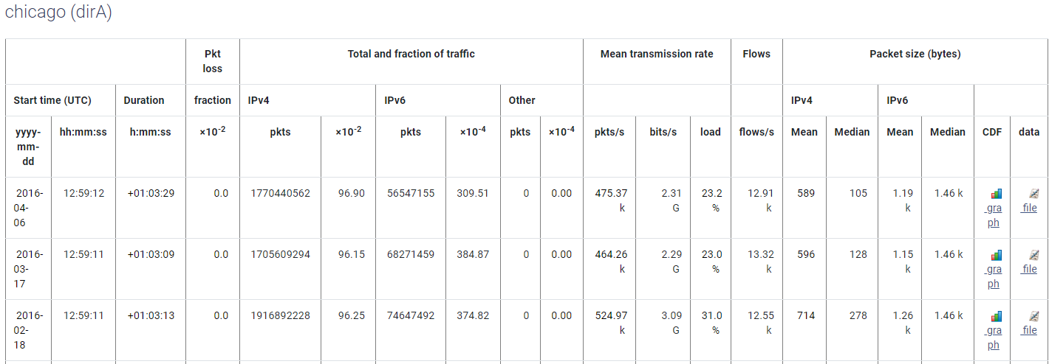
Magnified trade-off facing increasing network traffic rates
Notes:
This problem become worse as the internet grows and naturally, the amount of network traffic through at a given link also increases that we maybe observing traffic rate can go as high as 10s or 100s k flows per second.
Ex. caida passive measurement on a chicago datacenter

Slide 33
Demonstration: performance vs. efficiency trade-off
Performance
Better
F1-Score
Efficiency Overhead
TTD/Memory Consumption
Notes:
To sum it up, if we were to visualize performance and efficiency, the two types of classifiers tend to deviate severely towards one particular metric.
If the goal is to provide efficient classification of network traffic with acceptable accuracy,
This trade-off between conventional flow-statistics and packet-capture classifiers means that neither of them are ideal.

Slide 34
Our solution: Adaptive Constraint-Driven Classification (AC-DC)
Performance
Better
F1-Score
Efficiency Overhead
TTD/Memory Consumption
A framework to balance this trade-off.
Notes:
So the goal of our project is to explore a classification framework that aims to balance this trade-off under varying system resource constraints and traffic volume.

Slide 35
Our solution: Adaptive Constraint-Driven Classification (AC-DC)
Performance
Better
F1-Score
Efficiency Overhead
TTD/Memory Consumption
A framework to balance this trade-off.
Notes:
If we were to draw a line between these two existing methods, arriving at a more balanced trade-off means that we want to be able to achieve performance and efficiency that is to the left side of this line with the up right corner being the ideal solution with no trade off at all.

Slide 36
Content
Trade-off demonstration
Framework design
Evaluation results
Notes:
We now look at our framework design

Slide 37
High-level design principles
A naïve solution:
Notes:
So, to provide a good balance between performance and efficiency, we can first think of a naïve solution.

Slide 38
High-level design principles
A naïve solution:
a ‘magic’ classifier with adequate efficiency and performance
Notes:
An apparent one would be for us to just come up with a single …

Slide 39
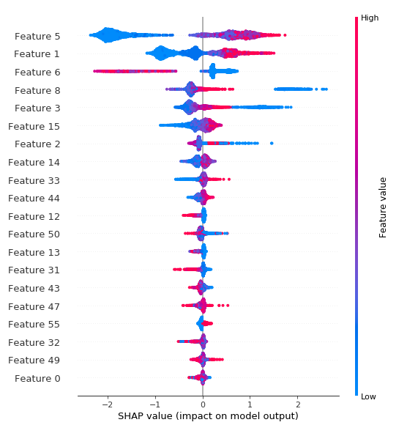
High-level design principles
A naïve solution:
a ‘magic’ classifier with adequate efficiency and
performance
e.g., iteratively cut down # features until desired
trade-off is reached
Notes:
For example, we can do this by training a classifier, look at its performance and efficiency measurements, and continue to cut down the features until an ideal trade-off is reached, and just use that classifier forever.

Slide 40
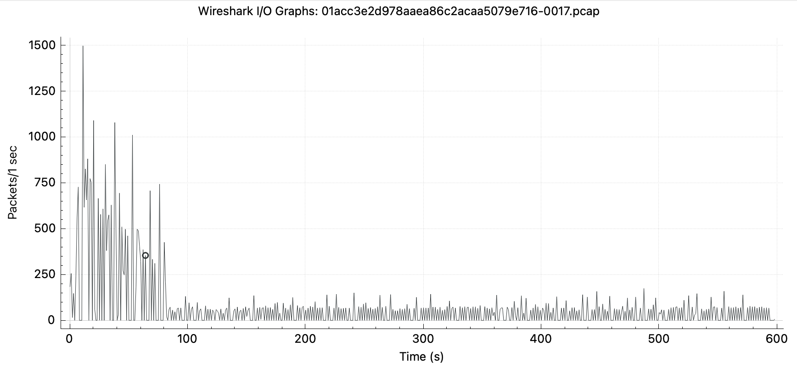
High-level design principles
A naïve solution: a ‘magic’ classifier with adequate efficiency and performance
Challenge: network traffic rate is extremely volatile.
Notes:
However, the problem is that, network is a very special scenario where the traffic rate is extremely volatile, for example we can have traffic rate at 1500 packets per second now and it can drop to 100 packets per second next.
(do flow per second chart)

Slide 41
High-level design principles
A naïve solution: a ‘magic’ classifier with adequate efficiency and performance
Challenge: network traffic rate is extremely volatile.
Low traffic rate: efficiency is less of a concern, we select for more features to maximize performance.
Notes:
When the network traffic rate is low, we are less concerned about the efficiency because whether it takes 0.1 second or 1 second to classify 100 flows does not really make that much difference is not going to kill my buffer, in this case, rather than excessively dialing down on the number of features to use to improve efficiency, we would rather keep those extra feature to improve performance.

Slide 42
High-level design principles
A naïve solution: a ‘magic’ classifier with adequate efficiency and performance
Challenge: network traffic rate is extremely volatile.
Low traffic rate: efficiency is less of a concern, we select for more features to maximize performance.
High traffic rate: efficiency becomes crucial, we need less feature requirement to boost up efficient at the cost of small performance degradation
Notes:
However, if I have traffic coming in at 10000 flows per second, then efficiency becomes importance because waiting for the classifier to take 10 or 20 seconds to finish prediction is just not going to work. In this case, then I would want to cut the number of feature the classifier relies on so I don’t overflow my buffer for example, even if this means that my accuracy performance might drop by a bit.
So it is nearly impossible and impractical to expect a simple classifier with a single set of feature requirement to meet these demands. So how to we solve this problem?

Slide 43
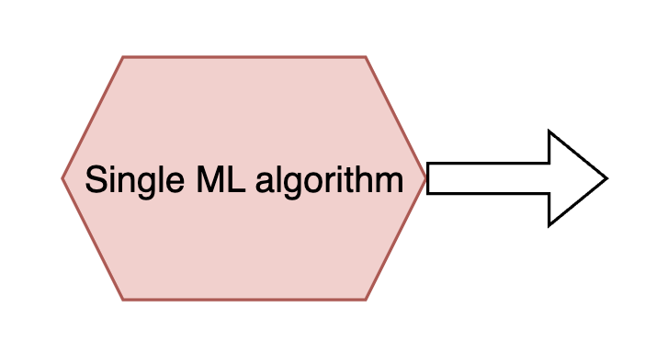
High-level design principles
Traditional Learning in ML
Notes:
Many of you problem know about ensemble learning but I am going to give a brief overview real quick.
So in traditional learning in ML, we typically select a single ML algorithm, train a classifier using this alg.

Slide 44
High-level design principles
Traditional Learning in ML
Prediction
Notes:
Which is then used to make predictions. However, this may not be satisfactory because a single algorithm maybe perfectly fit the problem at hand.

Slide 45
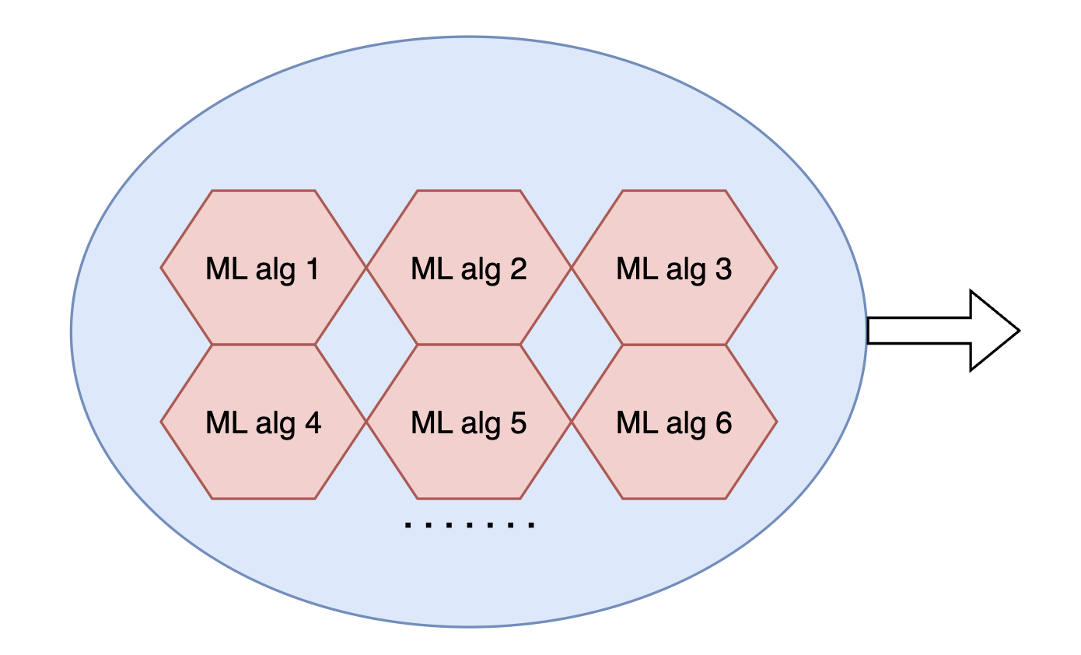
High-level design principles
Traditional Learning in ML
Ensemble Learning in ML
Prediction
Notes:
One way to address this is through ensemble learning where a wide variety of algorithms are used to train multiple classifiers.

Slide 46
High-level design principles
Traditional Learning in ML
Ensemble Learning in ML
Prediction
Weighted Prediction
Notes:
And weighted predictions are made utilizing all of the decisions from all of the algorithms.

Slide 47
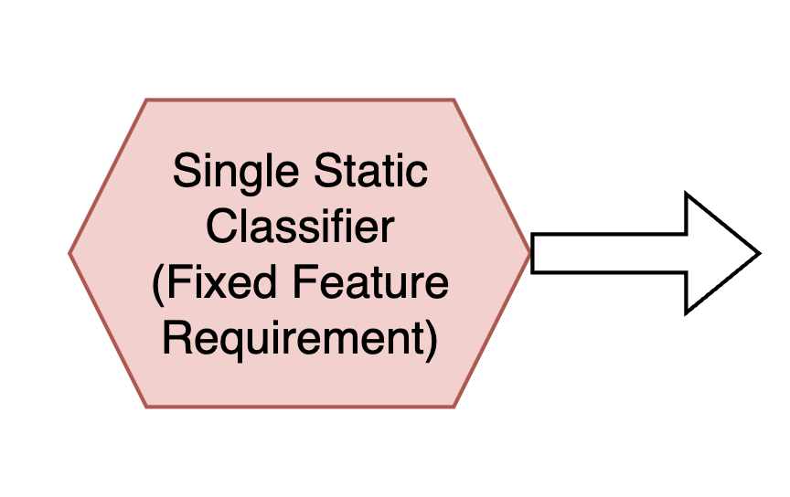
High-level design principles
Conventional Packet Capture Classifier
Notes:
Now consider a conventional packet capture classifier, it follows traditional ML learning by using a single static classifier, however we focus less on the algorithm but rather that the feature requirement of this classifier is fixated.

Slide 48
High-level design principles
Conventional Packet Capture Classifier
Fixed performance and efficiency
Notes:
As a result, the corresponding performance and efficiency outcome of this classifier is also fixed. No matter how the traffic rate changes, we can not adjust this classifier on the fly to meet the demands.

Slide 49
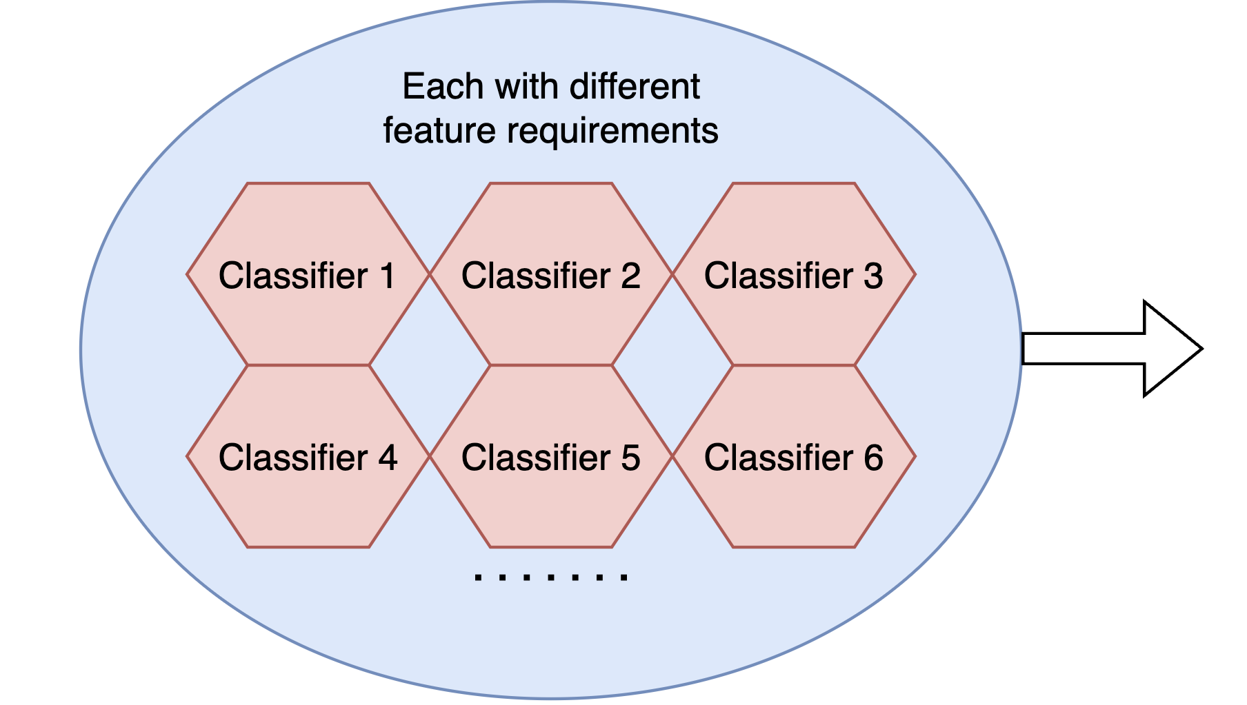
High-level design principles
Conventional Packet Capture Classifier
What we need
Fixed performance and efficiency
Notes:
However, like in ensemble learning, instead of having a single static classifier, we can create a pool of these classifiers, but unlike this traditional ensemble learning, instead of focusing on varying the algorithms each of these classifiers use, we instead changes the feature requirements of each one of these classifiers.

Slide 50
High-level design principles
Conventional Packet Capture Classifier
What we need
Fixed performance and efficiency
Flexibility in choosing performance and efficiency
Notes:
As a result, these classifiers are going to yield to different performance and efficiency trade-offs and allows the flexibility in choosing the appropriate classifier on the fly as network condition changes.

Slide 51
High-level design principles
Bottleneck of conventional packet-capture classifiers is in the preprocessing of large amounts of raw features.

Slide 52
High-level design principles
Bottleneck of conventional packet-capture classifiers is in the preprocessing of large amounts of raw features.
Less informative features used → better efficiency & worse performance

Slide 53
High-level design principles
For maximized performance
Use as many informative features as possible

Slide 54
High-level design principles
For maximized performance
Use as many informative features as possible
For maximized efficiency
Use as few features as possible

Slide 55
High-level design principles
Consider network traffic rates:
Low traffic rate: efficiency is less of a concern, we select for more features to maximize performance.

Slide 56
High-level design principles
Consider network traffic rates:
Low traffic rate: efficiency is less of a concern, we select for more features to maximize performance.
High traffic rate: efficiency becomes crucial, we less feature requirement to boost up efficient at the cost of small performance degradation

Slide 57
Question to ask
Given varying traffic rate, how can we consistently ensure both adequate performance and efficiency without severely compromising on either metric?

Slide 58
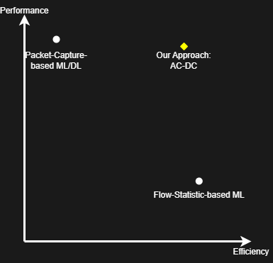
High-level design principles
When dealing with large volumes of network traffic, it is acceptable to make small sacrifices in performance to achieve higher efficiency and ensure that the classifier can function properly.

Slide 59
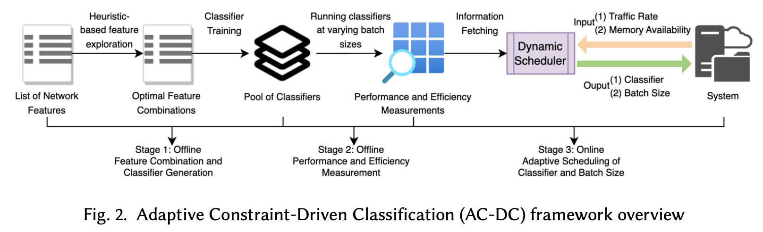
AC-DC
An ensemble framework to curate a pool of classifiers, each with varying feature requirements and, therefore, different performance-efficiency trade-offs.
Notes:
To realize this, we deliver ac-dc which is an ensemble frame that …, this empowers us to make an informed decision on selecting the most suitable classifier with different feature requirements to implement, based on the computational resources and traffic volume that are available at the time.
The framework composer of two off-line stages and one online stage which we now discuss in detail
'animate slide'

Slide 60
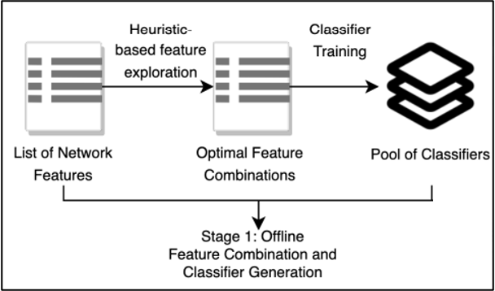
Stage 1: Heuristics-based Feature Exploration and Classifier Generation
Notes:
The framework starts off by carrying out heuristics-based feature exploration and classifier generation

Slide 61
Stage 1: Heuristics-based Feature Exploration and Classifier Generation
Question: how do we curate a set of classifiers with
Sufficient difference in performance-efficiency trade off to deal with different traffic rates
Notes:
As we showed that the core of our framework relies on this pool of classifiers, there are two questions to answer, first..

Slide 62
Stage 1: Heuristics-based Feature Exploration and Classifier Generation
Question: how do we curate a set of classifiers with
Sufficient difference in performance-efficiency trade off to deal with different traffic rates
Good balance between performance and efficiency
Notes:
Second, how do we ensure that these classifiers all maintain …

Slide 63
Stage 1: Heuristics-based Feature Exploration and Classifier Generation
Question: how do we curate a set of classifiers with:
Sufficient difference in performance-efficiency trade off to deal with different traffic rates
Good balance between performance and efficiency
Answers:
Populating the pool using classifiers with non-identical different feature requirements
Notes:
The answer to the first question is straightforward, we are going to populate … therefore we expect the performance-efficiency trade off to be different among them as both of these metrics depend heavily on the features in use.

Slide 64
Stage 1: Heuristics-based Feature Exploration and Classifier Generation
Question: how do we curate a set of classifiers with:
Sufficient difference in performance-efficiency trade off to deal with different traffic rates
Good balance between performance and efficiency
Answers:
Populating the pool using classifiers with non-identical different feature requirements
Classifiers with highest F1-Score-to-TTD ratio and F1-Score-to-Memory ratio
Notes:
For the second question, we answer it by aiming to curate classifiers … out of all the possible classifiers that can be constructed.

Slide 65
Stage 1: Heuristics-based Feature Exploration and Classifier Generation
Question: how do we curate a set of classifiers with:
Sufficient difference in performance-efficiency trade off to deal with different traffic rates
Good balance between performance and efficiency
Answers:
Populating the pool using classifiers with non-identical different feature requirements
Classifiers with highest F1-Score-to-TTD ratio and F1-Score-to-Memory ratio
How do we effective compute these ratios?
Notes:
But now the question is how do we compute these ratios.

Slide 66
Stage 1: Heuristics-based Feature Exploration and Classifier Generation
A naïve solution:
e.g., iteratively cut down # features to curate a
set of classifiers
Notes:
A naïve solution would just be what we suggested before, we just … based on the feature importance.

Slide 67
Stage 1: Heuristics-based Feature Exploration and Classifier Generation
A naïve solution:
e.g., iteratively cut down # features to curate a set of classifiers
Problem:
Outcome is unpredictable:
Notes:
But the problem with this is that…

Slide 68
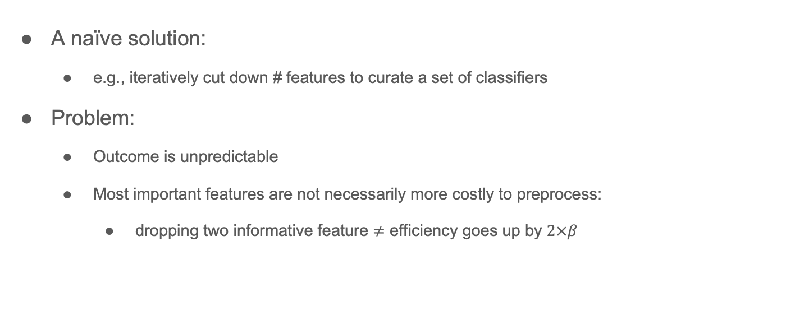
Stage 1: Heuristics-based Feature Exploration and Classifier Generation
A naïve solution:
e.g., iteratively cut down # features to curate a set of classifiers
Problem:
Outcome is unpredictable
Most important features are not necessarily more costly to preprocess:
dropping two informative feature $≠$ efficiency goes up by $2×β$
Notes:
That is …

Slide 69
Stage 1: Heuristics-based Feature Exploration and Classifier Generation
A less - naïve solution:
We try out all combinations of features
Notes:
A less naïve but more exhaustive solution is that we can … by training all possible classifier and measure the ratios.

Slide 70
Stage 1: Heuristics-based Feature Exploration and Classifier Generation
A less - naïve solution:
We try out all combinations of features
Problem:
The feature exploration space is large.
Notes:
But this is extremely impractical because…

Slide 71
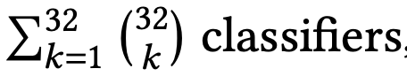
Stage 1: Heuristics-based Feature Exploration and Classifier Generation
A less - naïve solution:
We try out all combinations of features
Problem:
The feature exploration space is large.
e.g., feature space = 32:
Notes:
Consider a feature space of 32 features, this means the number of classifiers we have to train is equal to the summation from 32 choose k where k ranges from 1 to 32. Which is going to take forever to train.

Slide 72
Stage 1: Heuristics-based Feature Exploration and Classifier Generation
Our approximation-based solution:
Notes:
To solve this, we use an approximation based solution based on two observations

Slide 73
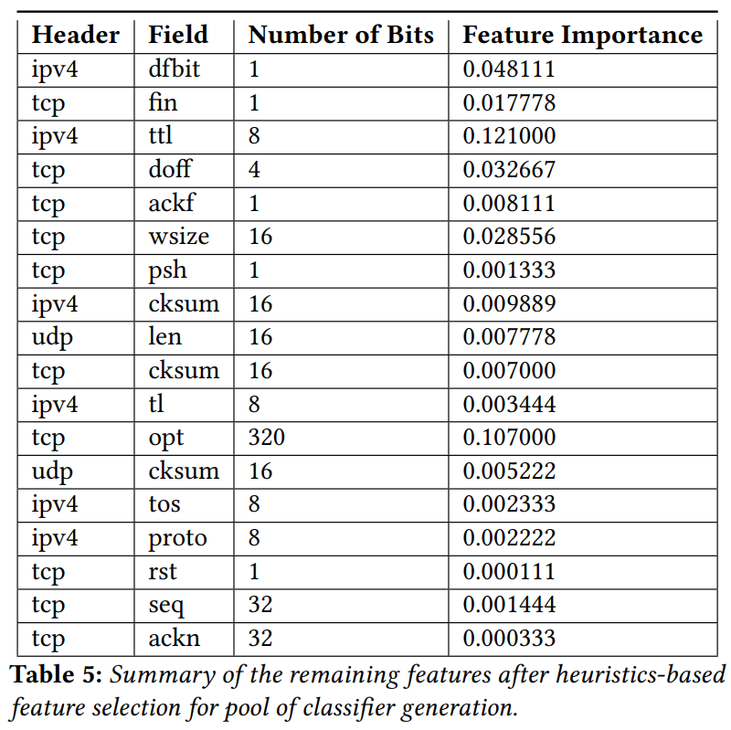
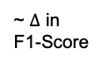
Stage 1: Heuristics-based Feature Exploration and Classifier Generation
Our approximation-based solution:
Approximate F1 by aggregated permutation shuffling feature importance (0.753 coefficients)
~ $Δ$ in
F1-Score
Notes:
We first show that, we can actually…

Slide 74
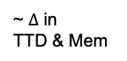
Stage 1: Heuristics-based Feature Exploration and Classifier Generation
Our approximation-based solution:
Approximate F1 by permutation shuffling feature importance (0.753 coefficients)
Approximate TTD and memory usage by the number of bits in features
~ $Δ$ in
TTD & Mem
~ $Δ$ in
F1-Score
Notes:
Second, we show that we can also .. With a near 0.99 correlation.

Slide 75
Stage 1: Heuristics-based Feature Exploration and Classifier Generation
Question: how do we curate a set of classifiers with:
Sufficient difference in performance-efficiency trade off to deal with different traffic rates
Good balance between performance and efficiency
Answers:
Populating the pool using classifiers with non-identical different feature requirements
Classifiers with most balanced F1-Score-to-TTD ratio and F1-Score-to-Memory ratio
Notes:
So now going back to the questions, we can answer the second question by approximating these ratios

Slide 76
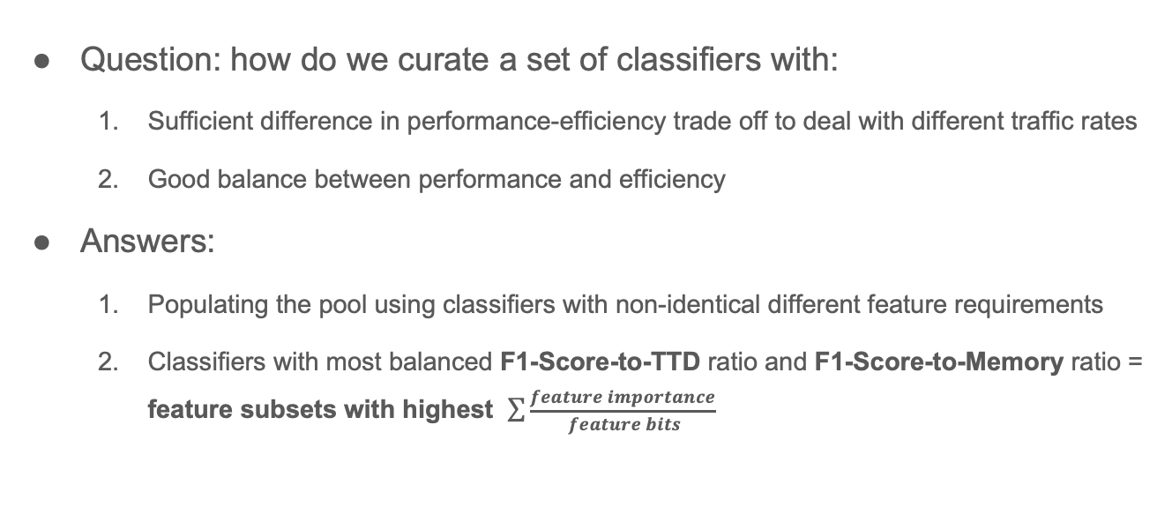
Stage 1: Heuristics-based Feature Exploration and Classifier Generation
Question: how do we curate a set of classifiers with:
Sufficient difference in performance-efficiency trade off to deal with different traffic rates
Good balance between performance and efficiency
Answers:
Populating the pool using classifiers with non-identical different feature requirements
Classifiers with most balanced F1-Score-to-TTD ratio and F1-Score-to-Memory ratio = feature subsets with highest $\sum{\frac{feature importance}{ feature bits}}$
Notes:
And only train classifier with the highest approximated ratios.

Slide 77
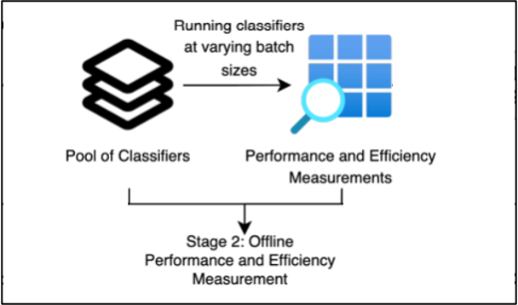
Stage 2: Performance and Efficiency Measurements at Varying Batch Sizes
Notes:
Given now we have this pool of classifier, we now obtain the performance and efficiency measurements on these classifiers.

Slide 78
Stage 2: Performance and Efficiency Measurements at Varying Batch Sizes
Previous Assumption*: A new classifier instance is called every second to classify all flows collected from the previous second.
Notes:
Recall our previous assumption when evaluating existing classifiers such that … This is because existing classifiers, particularly in network settings, do not elaborate on the concept of batch size.

Slide 79
Stage 2: Performance and Efficiency Measurements at Varying Batch Sizes
Previous Assumption*: A new classifier instance is called every second to classify all flows collected from the previous second.
We emphasize on Dynamic Batch Size:
The number of flows to process features for before ingesting the processed flows and executing an instance of the classifier.
Notes:
However, in our framework, we want to further provide additional flexibility and therefore a higher level of accommodation to network constraints so, we emphasize on the notion of dynamic batch size, which is the …

Slide 80
Stage 2: Performance and Efficiency Measurements at Varying Batch Sizes
Batch Size → Direct effects on TTD and memory requirement
Notes:
This is because batch size has …

Slide 81
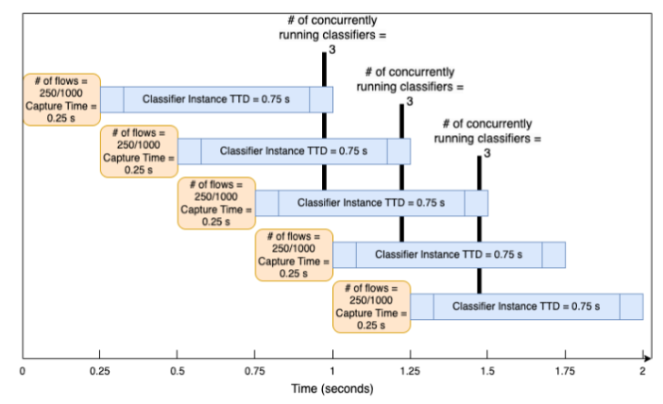
Stage 2: Performance and Efficiency Measurements at Varying Batch Sizes
Notes:
For example, consider traffic coming in at 1000 flows per second and the batch size is set at 250 flows. Under this batch size, selected classifier has a TTD of 0.75 second per instance, and the maximum number of concurrently running classifier instances is 3. It is easy to see that, if we vary the batch size, this concurrency is going to change accordingly, and this is not necessarily a linear relation, thus we want to capture the classifier behaviors under different batch sizes.

Slide 82
Stage 2: Performance and Efficiency Measurements at Varying Batch Sizes
Batch Size → Direct effects on TTD and memory requirement
Larger batch size → higher TTD and less concurrent classifier instances
Notes:
More generally, a larger batch size indicates …

Slide 83
Stage 2: Performance and Efficiency Measurements at Varying Batch Sizes
Batch Size → Direct effects on TTD and memory requirement
Larger batch size → higher TTD and less concurrent classifier instances
Smaller batch size → lower TTD and more concurrent classifier instances

Slide 84
Stage 2: Performance and Efficiency Measurements at Varying Batch Sizes
Why vary the batch sizes?
High impacts on the TTD and memory requirements (and number of concurrently running instances of the classifiers), particularly for packet-capture classifiers.
If the concept of batch size is not taken into account and classifier are ran periodically, for example, once per second, the associated efficiency overhead can become excessively high when the traffic rate is high.

Slide 85
Stage 2: Performance and Efficiency Measurements at Varying Batch Sizes
Notes:
As a result, during this offline stage, for each of the trained classifiers in the pool, we measure the performance and efficiency metrics at varying batch size and save this information.

Slide 86
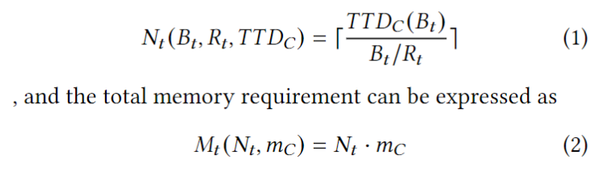
Stage 2: Performance and Efficiency Measurements at Varying Batch Sizes
Classifier measurement
Vary the batch size
Get all the measurements

Slide 87
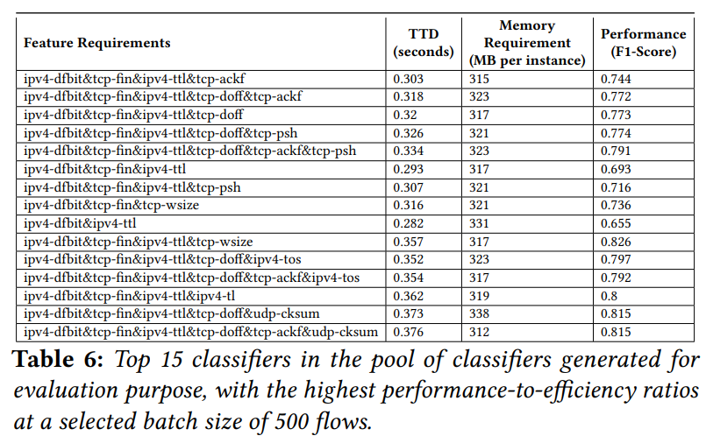
Stage 2: Performance and Efficiency Measurements at Varying Batch Sizes
Classifier measurement
Vary the batch size
Get all the measurements

Slide 88
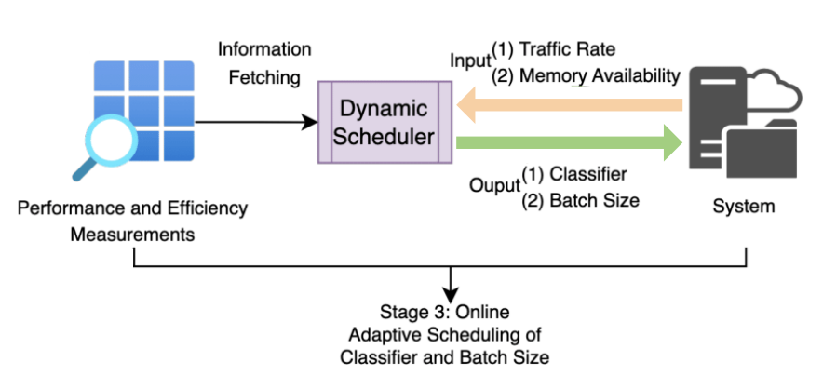
Online classification
Notes:
Now we come to the last component of the framework, During the online stage, a scheduler is implemented which serves a straightforward purpose,

Slide 89
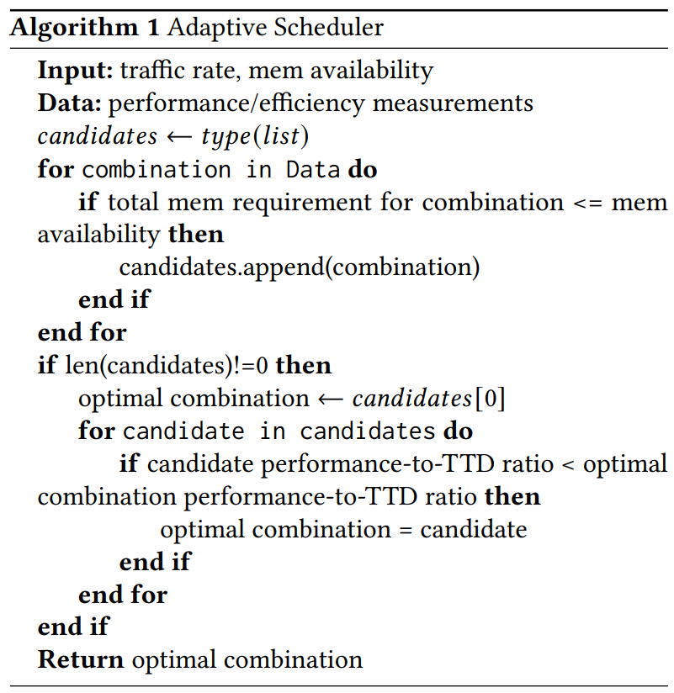
Online classification
Notes:
it takes the current traffic rate and memory availability on the system as inputs and conducts an
an iterative search to search through the performance and efficiency measurements and return the combination of classifier and batch size with the performance-to-TTD ratio under the current traffic rate without violating the current memory availability. This selected classifier is put into use and the scheduler periodically updates the selected to address changes in these network constraints. This conclude the framework design.

Slide 90
Online classification
Adaptive Scheduler
Optimization goal: an iterative approach to search through the performance and efficiency measurements and return the combination of classifier and batch size with the highest performance-to-TTD ratio under memory constraint and traffic rate.

Slide 91
Content
Trade-off demonstration
Framework design
Evaluation results
Notes:
We now show some of the evaluation results of ac-dc

Slide 92
Datasets and test bed
Ubuntu 20.04.4 LTS operating system
The CPU is an AMD EPYC 7502P 32-Core Processor.
Notes:
(1)~examining the DNS queries to identify IP addresses
relevant to the services/applications, (2)~filtering out irrelevant traffic to
contain only traffic associated with the applications/services using the
identified IP addresses, and (3)~separating traffic into individual flows using
the 5-tuple attributes (source and destination IP, source and destination port,
and the protocol field). We preserve two labels for each pre-processed flow
which include both the specific application, \eg, Netflix or YouTube, and the
type of macro service that generated the flow, \eg, video streaming or video
conferencing.

Slide 93
Evaluation
Questions to ask:
1. Does AC-DC offer better performance than flow-statistics classifiers?
Notes:
We want to answer several question during our evaluation, the first being…

Slide 94
Evaluation
Questions to ask:
1. Does AC-DC offer better performance than flow-statistics classifiers?
2. Does AC-DC offer better throughput efficiency than conventional packet-capture classifiers?
Notes:
The second is …

Slide 95
Evaluation
Questions to ask:
1. Does AC-DC offer better performance than flow-statistics classifiers?
2. Does AC-DC offer better throughput efficiency than conventional packet-capture classifiers?
3. Does AC-DC offer better memory efficiency than conventional packet-capture classifiers?
Notes:
Last we want to know.. We do this by comparing ac-dc’s performance and accuracy to the prominent conventional classifiers we previous introduce when applied to the same 10-class classification task.

Slide 96
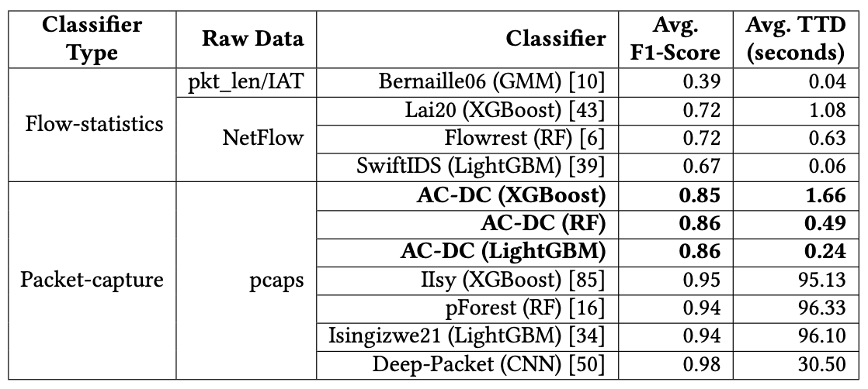
Performance Evaluation
1. Does AC-DC offer better performance than flow-statistics classifiers?
Notes:
First we look at ac-dc performance, for evaluation, we implement ac-dc with three different algorithms including.... just for a comprehensive evalaution, even though our focus is less on the alogrithms.
here we gradually increase the traffic rate from 1000 flows per second up to 15000 flows per second and report the average results. We can see that ac-dc is able to produce average F1-score that is 0.13 to 0.14 higher than the most accurate flow-statistics classifiers. But more impressively, with a significant performance boost, AC-DC’s TTD is very close to the flow-statistics classifiers while being orders of magnitudes faster than the packet capture classifiers.

Slide 97
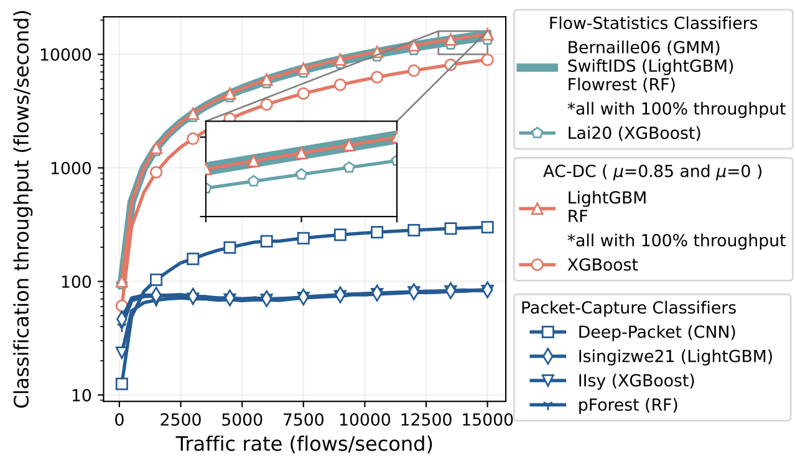
Throughput Evaluation
2. Does AC-DC offer better throughput efficiency than conventional packet-capture classifiers?
Notes:
Here we convert the TTD to classification throughput for an easier interpretation. Note that here we introduce a new notation mu to ac-dc which is a constrain variable that specifies to ac-dc of the minimum performance requirement that we need. Here we test ac-dc with mu set to 0.85 and when is not set. We can see that under all traffic rates, AC-DC can consistently produce classification throughput as high as the flow-statistic classifier while outperforming the conventional packet-capture classifiers significantly. When we enforce the minimum f1-score requirement, the throughput of ac-dc drop a bit overall because it's forced to selected classifiers with larger features space to meet the performance constraint and therefore higher TTD. But even with this additional constraint, ac-dc is able to significantly outperform the packet capture classfiers with higher throughput.

Slide 98
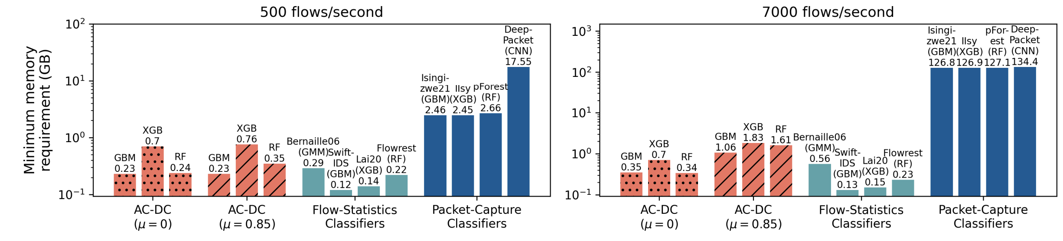
Memory Usage Evaluation
3. Does AC-DC offer better memory efficiency than conventional packet-capture classifiers?
Notes:
Last but not least, we look at ac-dc’s memory consumption at both high and low traffic rates, and we can easily tell that it’s memory consumption is significantly lower than the packet capture classifiers in both cases, especially when the traffic rate grows high our frame requires a fraction of the memories demanded by the packet capture classifiers. This shows that, under memory resource intensive deployment settings, for example local routers and switches, ac-dc is less prune to memory failures.

Slide 99
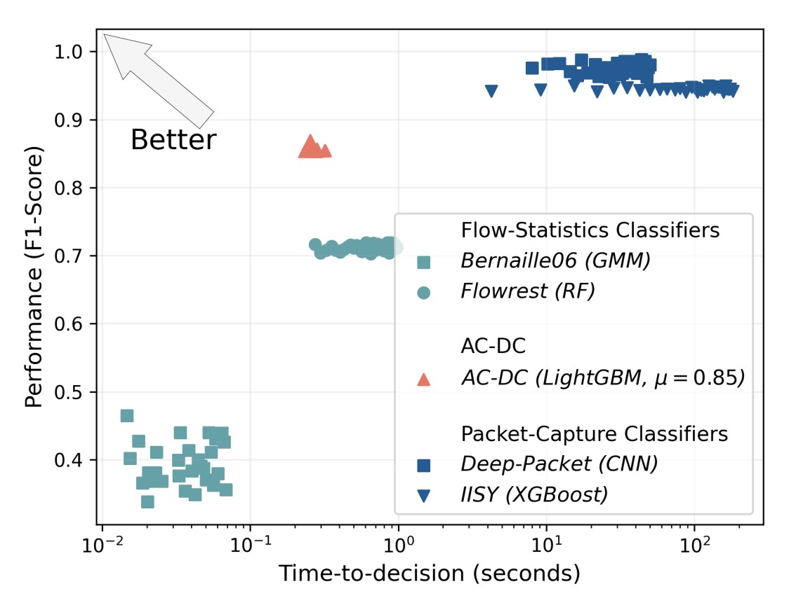
Performance vs. TTD
AC-DC shows more balanced trade-offs compared to both flow-statics and packet-capture classifiers.
Notes:
Putting everything in perspective, we selected the most balanced flow.. And packet capture… and compare them to ac-dc on the trade-off chart. We can see that ac-dc is able to yield a much balanced trade off than both of these type of classifiers.

Slide 100
Performance vs. TTD
AC-DC shows more balanced trade-offs compared to both flow-statics and packet-capture classifiers.
Notes:
And if we draw this trade-off line in existing classifiers, we see that AC-DC is able to stay on the left side of this line regardless of the volume it faces. We also carry out additional behavior analysis of ac-dc which can be found in the paper if interested.

Slide 101
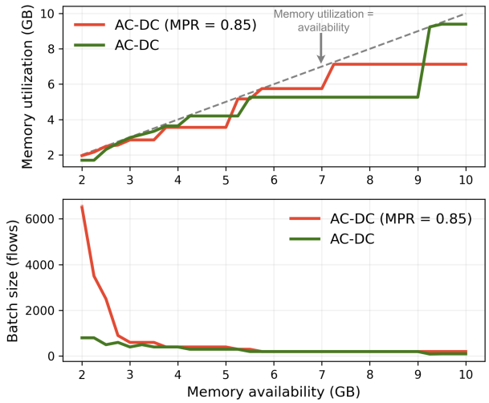
AC-DC under varying memory constraints and traffic rates
AC-DC capitalizes on available memory by lowering the batch size to allow for more concurrently running classifier instances, resulting in lower TTD and increased performance-to-TTD ratio.

Slide 102
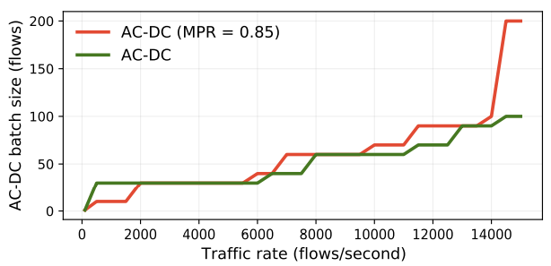
AC-DC under varying memory constraints and traffic rates
AC-DC increases batch size facing increasing traffic rate to conform to insufficient memory availability.

Slide 103
To summarize
We identify the bottleneck to optimize performance efficiency trade-off for traffic classification.
Notes:
To summarize,

Slide 104
To summarize
We identify the bottleneck to optimize performance efficiency trade-off for traffic classification.
We design the Adaptive Constraint-Driven Classification (AC-DC) framework to determine best reactions based on system constraints.

Slide 105
To summarize
We identify the bottleneck to optimize performance efficiency trade-off for traffic classification.
We design the Adaptive Constraint-Driven Classification (AC-DC) framework to determine best reactions based on system constraints.
We holistically evaluate AC-DC on different tasks, showing improved performance and faster processing rates.

Slide 106
Thanks! Questions?

Slide 107
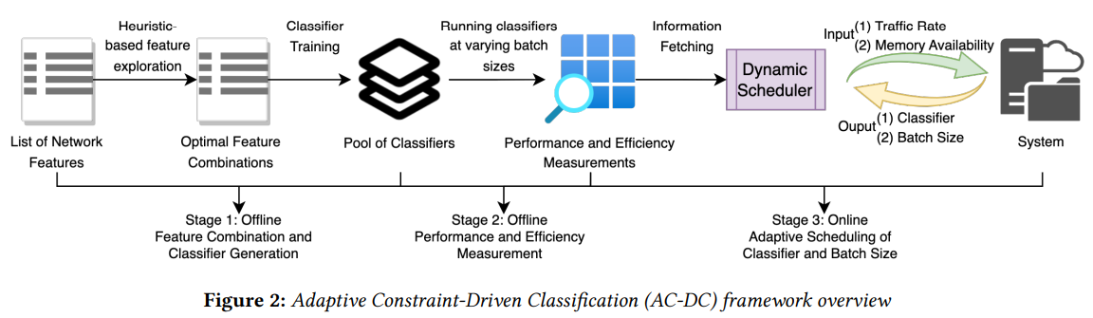
AC-DC
An ensemble framework to curate a pool of classifiers, each with varying feature requirements and, therefore, different performance-efficiency trade-offs.
Notes:
This empowers us to make an informed decision on selecting the most suitable classifier with different feature requirements to implement, based on the computational resources and traffic volume that are available at the time.

Slide 108
AC-DC
Previous Assumption*: A new classifier instance is called every second to classify all flows collected from the previous second.

Slide 109
AC-DC
Previous Assumption*: A new classifier instance is called every second to classify all flows collected from the previous second.
We emphasize on Dynamic Batch Size:
The number of flows to process features for before ingesting the processed flows and executing an instance of the classifier.

Slide 110
AC-DC
Batch Size → Direct effects on TTD and memory requirement

Slide 111
AC-DC
Batch Size → Direct effects on TTD and memory requirement
Larger batch size → higher TTD and less concurrent classifier instances

Slide 112
AC-DC
Batch Size → Direct effects on TTD and memory requirement
Larger batch size → higher TTD and less concurrent classifier instances
Smaller batch size → lower TTD and more concurrent classifier instances

Slide 113
AC-DC
An ensemble approach to curate a pool of classifiers, each with varying feature requirements and, therefore, different performance-efficiency trade-offs.
Notes:
This empowers us to make an informed decision on selecting the most suitable classifier with different feature requirements to implement, based on the computational resources and traffic volume that are available at the time.

Slide 114
Stage 1: Heuristics-based Feature Exploration and Classifier Generation

Slide 115
Stage 1: Heuristics-based Feature Exploration and Classifier Generation
Packet capture feature representation → nPrint bits

Slide 116
Stage 1: Heuristics-based Feature Exploration and Classifier Generation
Preliminary feature selection → 1088 bit level features on IPv4, TCP, and UDP headers

Slide 117
Stage 1: Heuristics-based Feature Exploration and Classifier Generation
Given high traffic rate, how do we preserve performance while improving efficiency by reducing the feature requirements?

Slide 118
Stage 1: Heuristics-based Feature Exploration and Classifier Generation
Q. Given high traffic rate, how do we preserve performance while improving efficiency by reducing the feature requirements?
A. Create candidate classifiers with high (1) performance-to-TTD and (2) performance-to-memory requirement ratios.

Slide 119
Stage 1: Heuristics-based Feature Exploration and Classifier Generation
How do we preserve performance while improving efficiency as we reduce the feature requirements?
Create candidate classifiers with high (1) performance-to-TTD and (2) performance-to-memory requirement ratios, i.e., finding feature subsets that strike a good balance between performance and efficiency.

Slide 120
Stage 1: Heuristics-based Feature Exploration and Classifier Generation
Challenge:
The feature exploration space is large.
Solution:
Approximate F1 by permutation shuffling feature importance (0.753 coefficients)
Approximate TTD and Mem by the bits of features

Slide 121
Stage 1: Heuristics-based Feature Exploration and Classifier Generation
We can satisfy performance and efficiency preservations by finding optimal feature subsets with highest sums of feature importance to number of bits ratios.
The computed feature subsets are then used as feature requirements to obtain trained models.

